Slide 1
Problem F.
By Group 23

Slide 2
Q : If any NPC problem can polynomially reduce to another NPC problem ?

Slide 3
A : True

Slide 4
But why ?

Slide 5
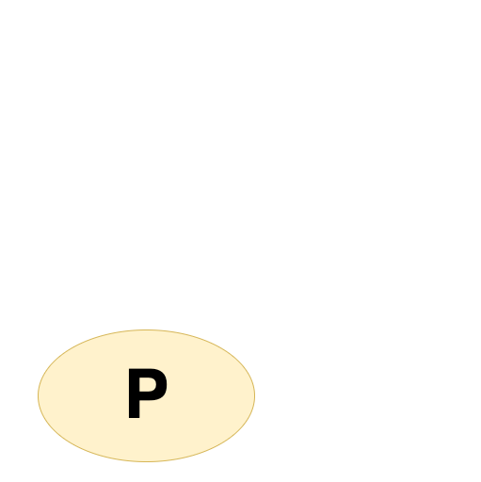
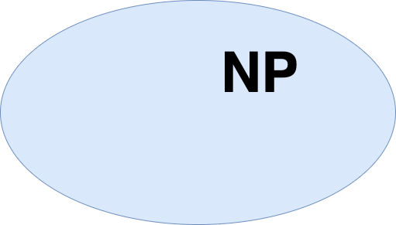
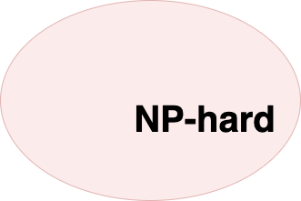


Slide 11
Thank you for listening !

